Slide 1
Sales Data Optimization
Detailed
Solution Description

Slide 2
Contents
Introduction
Solution Overview
Solution Components
  Business Application: OOS
  Rapid Implementation Methodology
  Diagnostic Module: Benefits Calculation

Slide 3
Contents
Introduction
Solution Overview
Solution Components
  Business Application: OOS
  Rapid Implementation Methodology
  Diagnostic Module: Benefits Calculation

Slide 4
The Challenge Remains the Same … But The Approach Must Change
The Retail Challenge
To Win, Retailers Must
Get Real
Right Product
Right Place
Right Time
Right Price
Right Way
Real Focused
Real Efficient
Real Smart
Real Close
All in Real Time
Sustainable growth will come from an increased understanding of consumers needs and a mixture of “Art” and “Science”

Slide 5

Real Time Retail – Driving Growth at the Point of Decision
Real-time connections with:
  Consumers
  Partners
  Stores
Significant impact on:
  Customer Service
  Inventory Management
  Pricing / Promotions
  Purchasing
Technology-enablers include:
  Collaborative Value Chains
    CPFR
    CPC
    SDO
  In-store wireless CRM
  RFID / Auto-ID

Slide 6
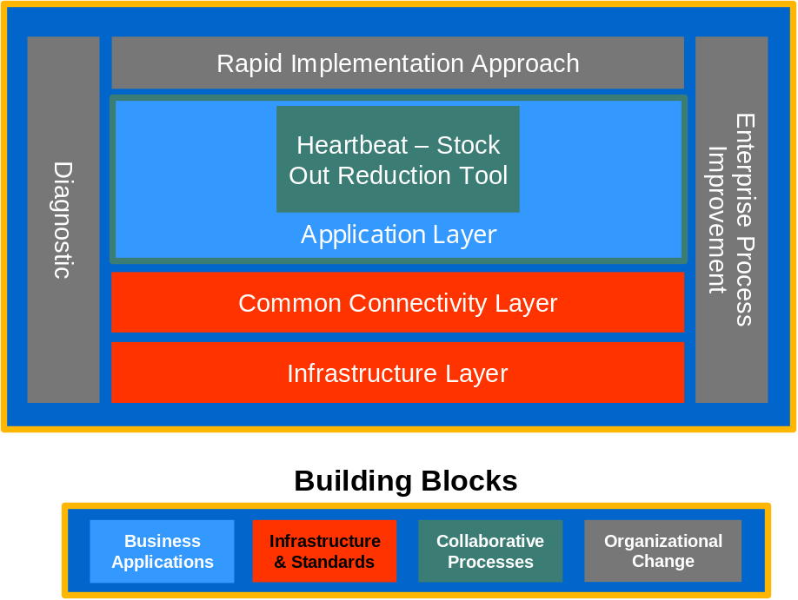
SDO Architecture Lays the Foundation for Data Availability Which Can be Leveraged for Supply Chain Optimization and CRM Opportunities
A scalable architecture
Industry standard transaction templates and message formats
Real time data access
Flexible operating environment
  Retailer supported (In-store or Corporate)
  ASP Model
The SDO Architecture acts as a hub providing on demand access to store transactional data; allowing a variety of services to analyze and respond to the store environment in real time

Slide 7
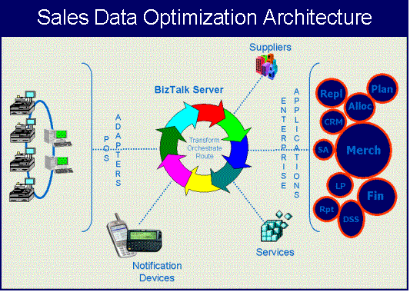
SDO Architecture Lays the Foundation for Data Availability Which Can be Leveraged for Supply Chain Optimization and CRM Opportunities
A scalable architecture built on the Microsoft BizTalk platform
Industry standard transaction templates and message queuing
Real time data access
Flexible operating environment
  Retailer supported (In-store or Corporate)
  ASP Model
The SDO Architecture acts as a hub providing on demand access to store transactional data; allowing a variety of services to analyze and respond to the store environment in real time

Slide 8
The Building Blocks That are Necessary to Achieve Success
Provides visibility into product movement for predictive and other statistical modeling
Enables focused store-level response to problem conditions
Provides insight into inventory movement to refine forecasting and inventory management models
Business
Applications
Provides database coding, communications protocols and interface templates to allow solution partners to read data and execute processes consistently
Reduces implementation time
Increases accessibility of POS transactional data
Infrastructure & Standards
Enables stores, corporate, manufacturer and direct to store suppliers to work effectively together across company boundaries
Allows partners to understand information, make decisions and respond quickly to opportunities and challenges
Collaborative Processes
Provides adoption of methods to facilitate intra- and inter-enterprise change
Enhances collaborative relationships between participants internally and externally
Provides the ability to work together to exploit opportunities and mitigate risks
Organizational
Change

Slide 9
Contents
Introduction
Solution Overview
Solution Components
  Business Application: OOS
  Rapid Implementation Methodology
  Diagnostic Module: Benefits Calculation

Slide 10
Heartbeat – Stock Out Reduction Tool (SORT)
D.V.
Findings From Pilot Implementations
Reduce out-of-stocks by 25%
Average revenue increase of 1 - 2%
Average revenue increase of top 200 items of 5 – 6%
Increase sales per square foot
Improve margins
Improve sales forecasting
Decrease inventory levels
POS
SDO
STORE
Software
DATA VENTURES, SYSTECH
Op System
MICROSOFT W2K
Hardware
INTEL - BASED
Wireless
PAGERS, PDA, CELLULAR
Web Svcs
MICROSOFT .NET

Slide 11
Heartbeat - SORT Creates Value for Each Member of the Supply Chain
Manufacturer
Retailer
Consumer
Increase sales
Improve profitability
Improve brand loyalty
Reduce inventory
Improve customer service / loyalty
Increase sales
Improve margin
Improve utilization of staff
Increase stock turns
Reduce inventory
Improve availability of product
Improve shopping experience

Slide 12
SDO delivers critical functionality in a modular fashion
SDO addresses those processes that are typically the bottlenecks that cause the bulk of the expense in the trading community:
  Inventory management
  P.O. management
This proven solution set includes:
  Benefits Diagnostic that identifies key opportunities and lays the path for a quick time to benefit
  Project Organization, Start-up and implementation
  High level hardware and software architecture
  Implementation methodology for a tailored solution
  Process re-design and change management to attain quick ROI
  “On-Boarding” of supply chain partners
Diagnostic
Rapid Implementation Approach
Enterprise Process Improvement
Application Layer
Heartbeat – Stock Out Reduction Tool
Common Connectivity Layer
Infrastructure Layer
Building Blocks
Business
Applications
Infrastructure & Standards
Collaborative Processes
Organizational Change

Slide 13
Contents
Introduction
Solution Overview
Solution Components
  Business Application: OOS
  Rapid Implementation Methodology
  Diagnostic Module: Benefits Calculation

Slide 14
The Sales Data Optimization effort includes a comprehensive Rapid Implementation methodology
SDO Implementation Methodology
Analysis
Definition
Design
Construction
Deploy, Support, Improve

Slide 15
Analysis
SDO
Methodology
Envisioning
  Scope definition
  Identify items / categories to be tracked by “Heartbeat”
  Establish baseline metrics
Process Analysis
  Review ordering and inventory management processes
  Review current in-store stocking processes
Systems / Data Analysis
  Review existing technical environment
  Identify data sources and formats
Project Planning
  Identify project resources
  Validate timeline
  Validate project budget
  Define project controls and reporting methods

Slide 16
Definition
SDO
Methodology
Process Definition
  Define target re-stocking process for Heartbeat items
    Resource coverage
    Item / category prioritization
  Define target inventory management processes
    Store ordering
    Store replenishment
    Centralized purchasing
Define Tracking / Alert Requirements
  Define performance targets
  Define reporting requirements
  Define alert requirements / formats
Technical Definition
  Data requirements definition
  System definition (local server, centralized server, ASP)
  Infrastructure definition
  Hardware (servers, PDA, wireless)
Documentation & Training Definition

Slide 17
Design
SDO
Methodology
Design SDO Architecture
  Design Infrastructure
  Size Heartbeat applications and database
Design SDO Interfaces
  Map POS data elements
Design Reports / Alert
  Design alert criteria / formats
  Design reports
Change Management
  Establish performance tracking processes
  Develop training program / set training schedule
    In-store processes
    Inventory management / ordering processes
Deployment Plan

Slide 18
Construction
SDO
Methodology
Development
  Construct SDO interfaces
  Construct alert messages
  Construct reports
Testing
  Functional / integration testing
  Performance / stress testing
  User acceptance testing
Change Management / Training
  Prepare training documents
  Train store personnel
  Knowledge transfer plans and processes
  Knowledge transfer performance measurements
Installation / Set-up
  Set-up infrastructure
  Install hardware / OS / database
  Install BizTalk / Data Ventures applications

Slide 19
Deploy, Support and Improve
SDO
Methodology
Pilot Set-up and Testing
  Set-up initial pilot stores
  Test pilot stores
  Monitor pilot program / resolve issues
Deployment Planning
  Refine deployment plan based on pilot findings
  Execute roll out
  Provide on going support
Continuous Improvement
  Analyze results
  Identify improvement opportunities
  Expand program leveraging opportunities

